Slide 1


Consumer Goods Ad Hoc Analysis
AtliQ Hardware
Presented by
Ashutosh Jaiswal

Slide 2
Agenda
About Atliq Hardwares
Objectives and Challenges
Business Overview
Understanding the Data
Methodologies and Tools Used
Data Analysis Approach
Key Insights and Findings from the Ad hoc requests
Conclusion

Slide 3
Business Overview
Atliq Hardwares, a top computer hardware producer in India and other countries, needs better data insights to make smart decisions.
To fix this, they want to hire junior data analysts and grow their analytics team.
Tony Sharma, the data analytics director, created a SQL challenge to test candidates' tech and soft skills.
The challenge involves solving 10 business questions using SQL to extract insights from company data.
This test checks candidates' SQL skills, analytical thinking, and ability to explain data clearly.
Atliq Hardwares wants to find talented people who can help make data-driven decisions and support the company's growth.

Slide 4
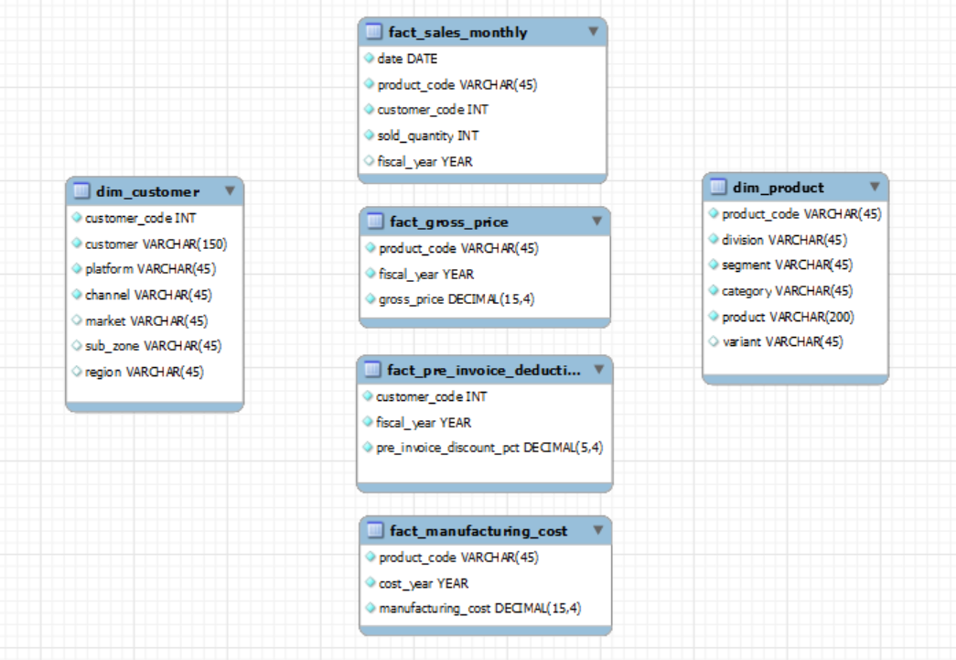
Data Overview
Given the sales data from the fiscal years 2020 and 2021, the data is provided in the fact tables and dimension tables.
Note: Fiscal year from (September to August)

Slide 5



Tools Used for Analysis
MySql for data querying and manipulation
Power BI for data insights
Google Slides for presentation

Slide 6

AD HOC QUERY REQUESTS
QUERY RESULTS AND INSIGHTS

Slide 7
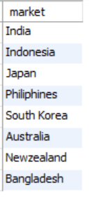
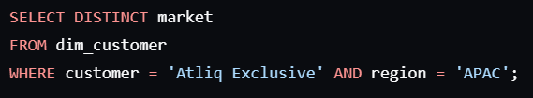
Request 01
Output
Provide the list of markets in which customer "Atliq Exclusive" operates its business in the APAC region.
Query

Slide 8
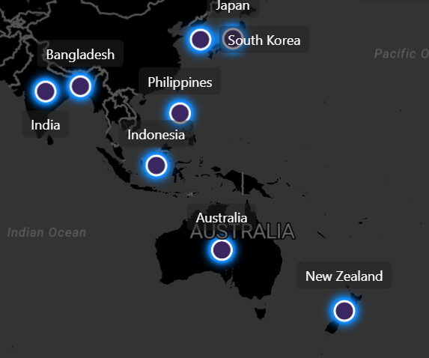
Request-1
Insight
Identified distinct markets in the APAC region where "Atliq Exclusive" operates.
Recommendation:
Focus marketing efforts on these identified markets to strengthen the brand presence.

Slide 9
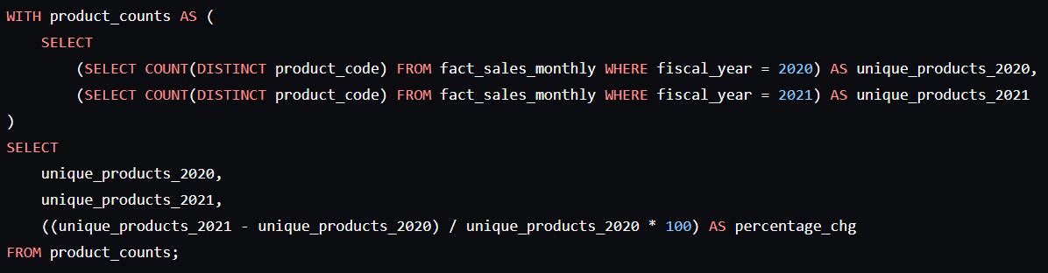
Request-2
What is the percentage of unique product increase in 2021 vs. 2020?
Query

Slide 10
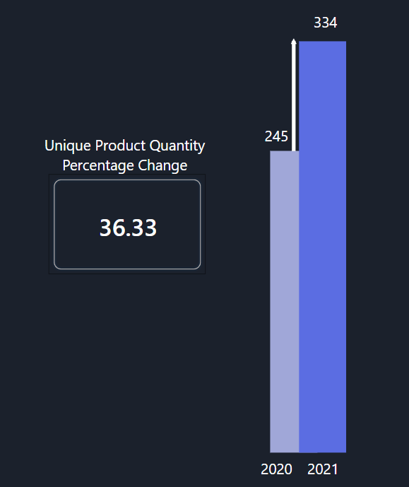
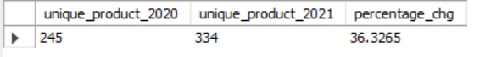
Request-2
Unique Products Quantity 2020
Vs Unique Products Quantity 2021
Output
Insight
There was a significant increase of 36.33% in unique products in 2021 compared to 2020.
Recommendation:
Continue product innovation to maintain growth and consider scaling successful products.

Slide 11
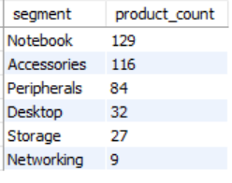
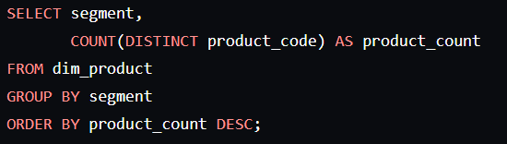
Request-3
Output
Provide a report with all the unique product counts for each segment and sort them in descending order of product counts.
Query

Slide 12
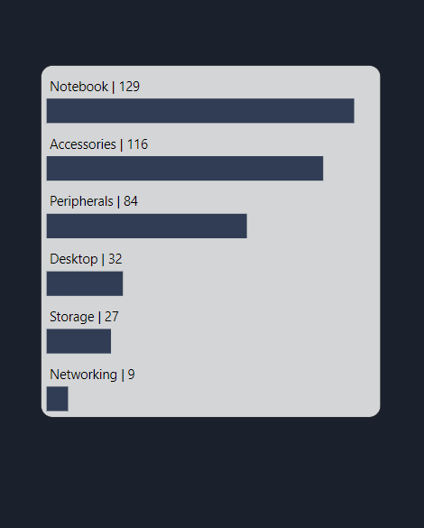
Request-3
Unique Product Counts by Segments
Insight
The segment with the highest count of unique products is notebooks with 129.
Other segments include accessories (116), peripherals (84), desktops (32), storage (27), and networking, which has the lowest count of 9.
Recommendation:
Invest in R&D for the notebook segment to leverage its large product base.
Explore opportunities to expand and innovate in the accessories and peripherals segments due to their substantial product counts.
Consider strategies to boost the product line in lower-count segments like storage and networking to diversify offerings.

Slide 13
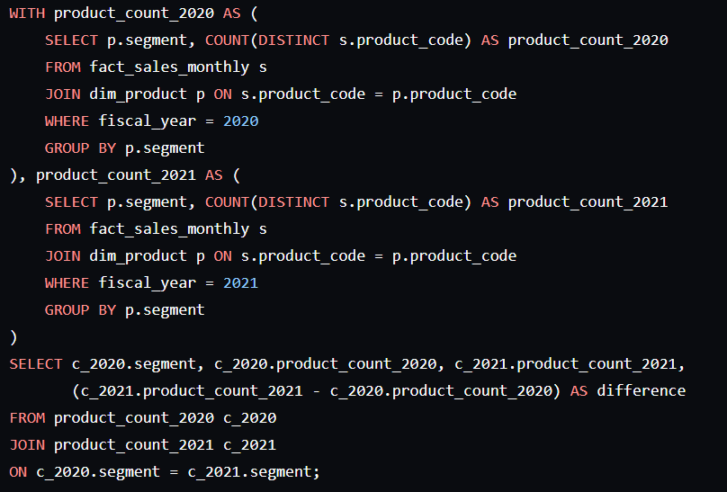
Which segment had the most increase in unique products in 2021 vs 2020?
The final output contains these fields, segment, product_count_2020, product_count_2021 and Difference
Request-4
Query

Slide 14
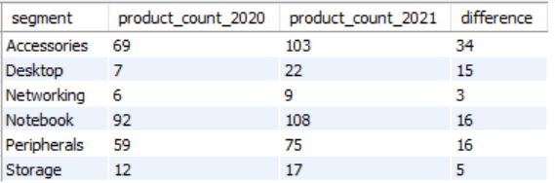
Which segment had the most increase in unique products in 2021 vs 2020?
The final output contains these fields, segment, product_count_2020, product_count_2021 and Difference
Request-4
Output

Slide 15
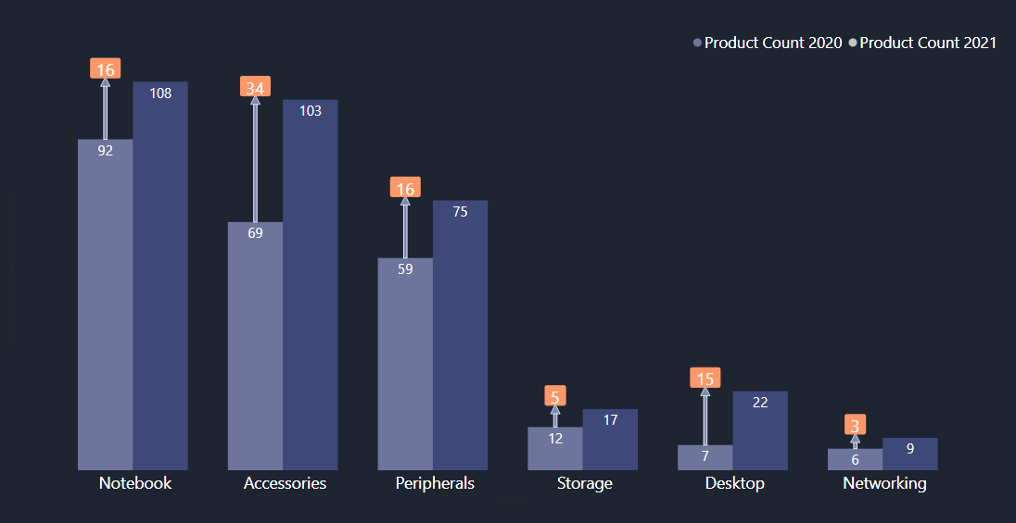
Request-4 Insight
Unique Product difference by Segments for FY 2020 and FY 2021

Slide 16
Request-4
Insight:
The Accessories segment experienced the largest increase in unique products from 2020 to 2021.
The networking segment had the lowest increase.
Recommendation:
Focus additional resources on the Accessories segment to capitalize on its significant growth.
Implement targeted marketing and sales strategies to enhance its market presence.
Evaluate customer feedback and market trends in this segment to drive innovation and maintain the growth trajectory.
Consider strategies to boost the product line in the networking segment to diversify offerings and stimulate growth.

Slide 17
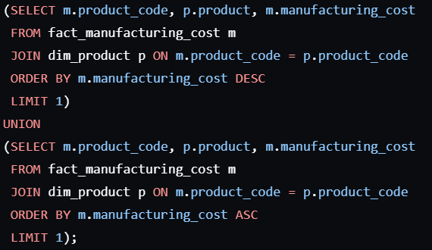
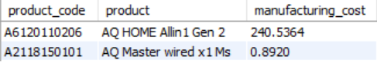
Get the products that have the highest and lowest manufacturing costs.
The final output should contain these fields product_code, product and manufacturing_cost
Request-5
Query
Output
Output

Slide 18


Request-5 Insight
Maximum manufacturing cost
Minimum manufacturing cost
240.54 $
0.89 $
AQ HOME Allin1 Gen 2
AQ Master wired x1 Ms
( A6120110206 )
( A2118150101 )

Slide 19
Request-5
Insight:
Identified the products with the highest and lowest manufacturing costs.
Recommendation:
Conduct a thorough review of production processes for high-cost products to identify potential cost-saving measures.
Analyze the production methods of low-cost products to replicate efficient practices across other product lines.
Consider supplier negotiations and bulk purchasing strategies to reduce raw material costs.
Implement continuous improvement initiatives to streamline manufacturing processes and enhance cost efficiency.

Slide 20
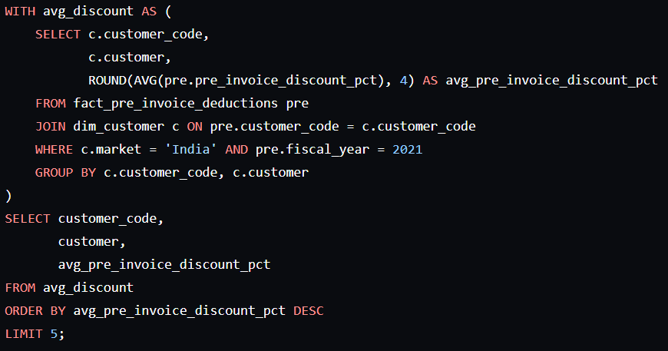
Generate a report which contains the top 5 customers who received an average high pre_invoice_discount_pct for the fiscal year 2021 and in the Indian market.
The final output contains these fields, customer_code, customer and Average_discount_percentage
Request-6
Query
Output

Slide 21
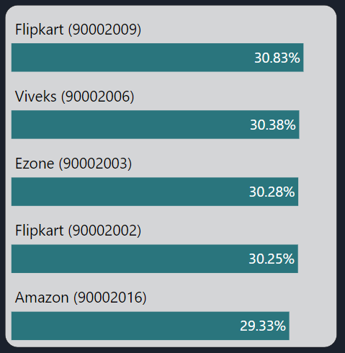
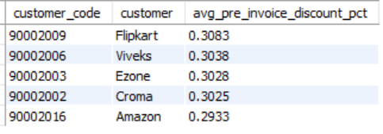
Request-6 Insight
Top 5 Customers with highest average discount percentage for FY 2021
Output

Slide 22
Request-6
Insight:
Identified the top 5 customers in India with the highest average pre-invoice discount percentage in 2021.
Recommendation:
Engage in negotiations to secure more favorable terms with these high-discount customers, thereby improving profit margins.
Analyze the purchasing patterns and discount structures to find opportunities for cost optimization.
Implement loyalty programs or volume-based incentives to maintain customer satisfaction while reducing the average discount rate.
Explore alternative pricing strategies that align with business objectives without compromising customer relationships.

Slide 23
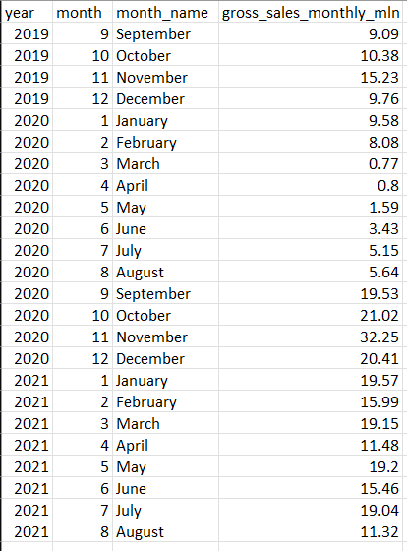
Output
Request-7
Get the complete report of the Gross sales amount for the customer “Atliq Exclusive” for each month .
This analysis helps to get an idea of low and high-performing months and take strategic decisions.
The final report contains these columns:
Month
Year
Gross sales Amount

Slide 24
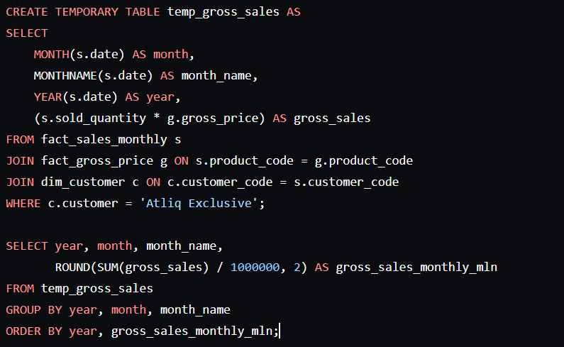
Request-7
Get the complete report of the Gross sales amount for the customer “Atliq Exclusive” for each month .
This analysis helps to get an idea of low and high-performing months and take strategic decisions.
The final report contains these columns: Month, Year and Gross sales Amount
Query

Slide 25
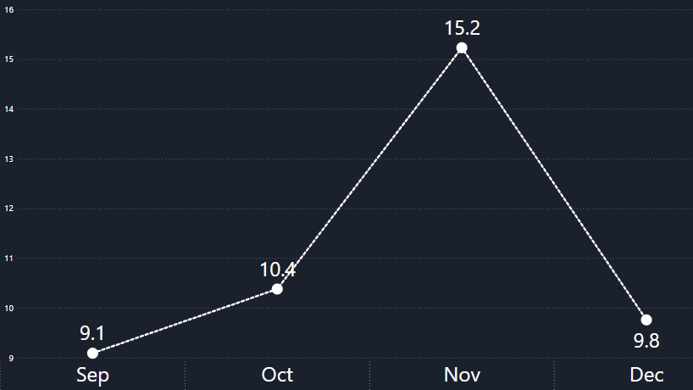
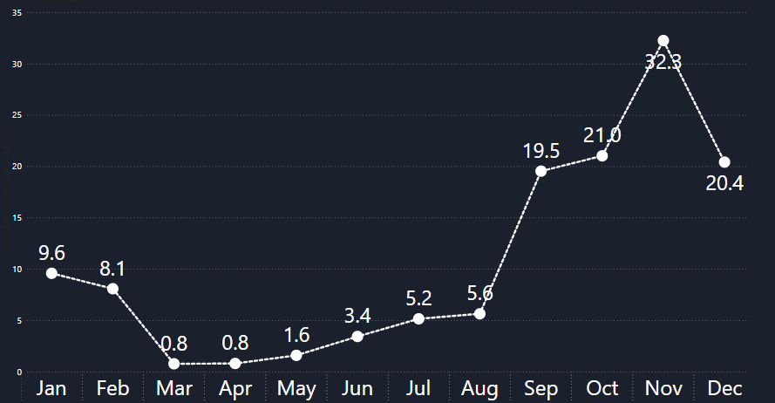
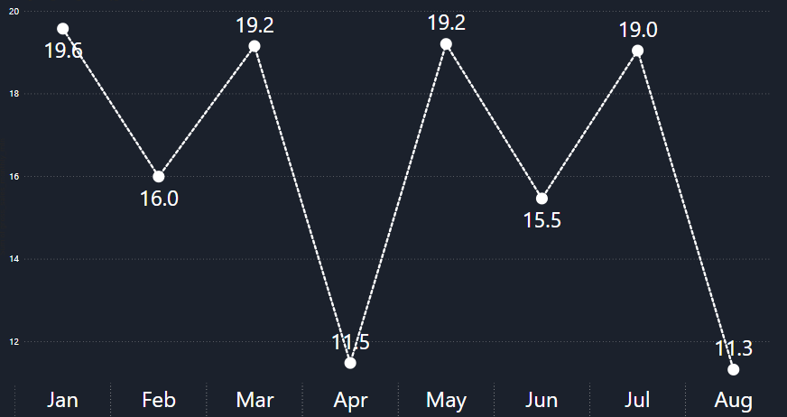
Request-7 Insight
Monthly Gross Sales
in Million
2019
2020
2021

Slide 26
Request-7
Insight:
Monthly gross sales for "Atliq Exclusive" show peak sales in November for both 2019 and 2020.
Sales declined in March 2020 and April 2021.
Recommendation:
Plan major promotions and marketing efforts in November to capitalize on peak sales periods.
Increase inventory levels before November to meet higher demand and avoid stockouts.
Investigate the reasons for sales declines in March 2020 and April 2021, and implement targeted marketing strategies or discounts during these months to boost sales.
Adjust inventory and operational strategies to ensure resilience during low sales periods

Slide 27
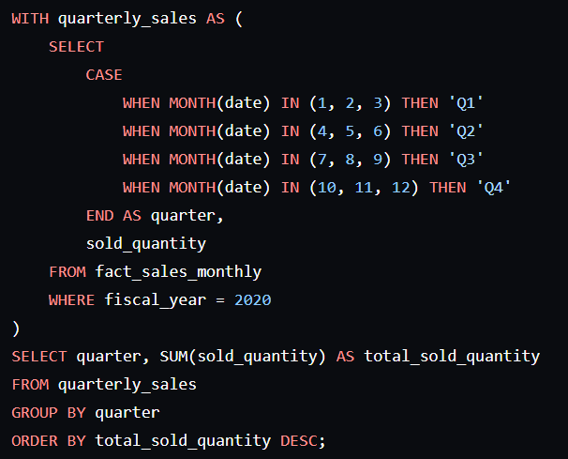
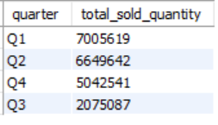
Request-8
In which quarter of 2020, got the maximum total_sold_quantity?
The final output contains these fields sorted by the total_sold_quantity, Quarter, total_sold_quantity
Query
Output

Slide 28
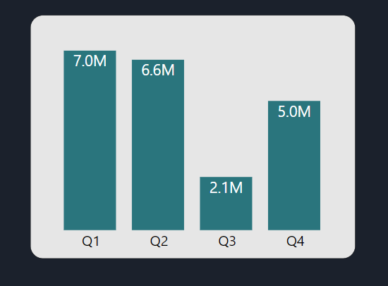
Request-8
Total Sold Quantity by Quarter for FY 2020
Insight:
Q1 2020 had the highest total sold quantity at around 7 million units.
Q3 2020 had the lowest at approximately 2.1 million units.
Recommendation:
Analyze and replicate the successful strategies from Q1 in future sales cycles.
Identify and address factors contributing to the decline in Q3 to enhance sales performance.
Adjust marketing and sales efforts based on seasonal trends and external factors to maintain consistent sales throughout the year.

Slide 29
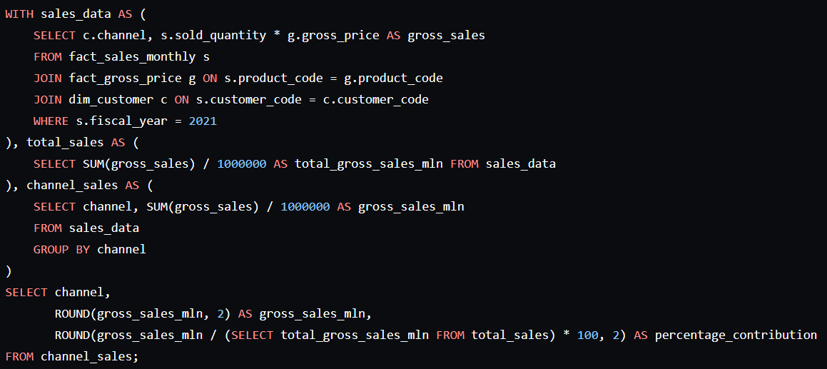
Which channel helped to bring more gross sales in the fiscal year 2021 and the percentage of contribution?
The final output contains these fields, channel, gross_sales_mln, percentage
Request-9
Query

Slide 30
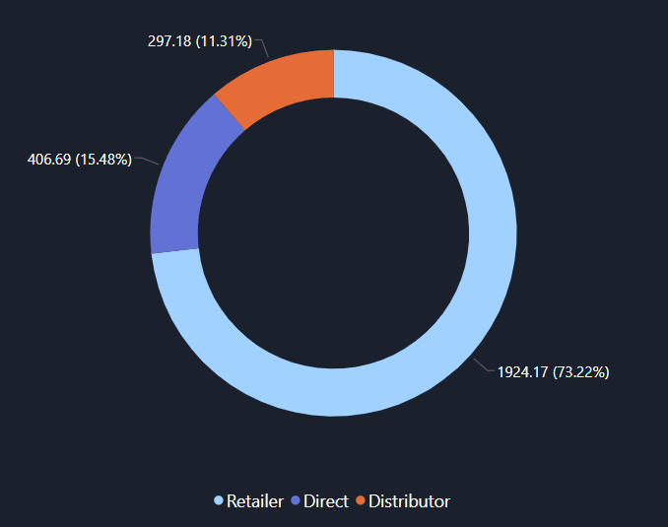
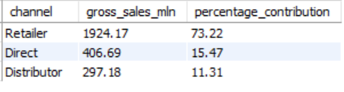
Request-9
Output
Channel Sales Contribution In
FY 2021

Slide 31
Request-9
Insight:
Retailer channel led with 73.22% of total gross sales.
Direct sales contributed 15.47%.
Distributor sales contributed 11.31%.
Recommendation:
Strengthen relationships and marketing efforts with retail partners.
Enhance direct and distributor sales strategies to diversify revenue streams and reduce reliance on retailers.
Channel Sales Contribution In
FY 2021

Slide 32
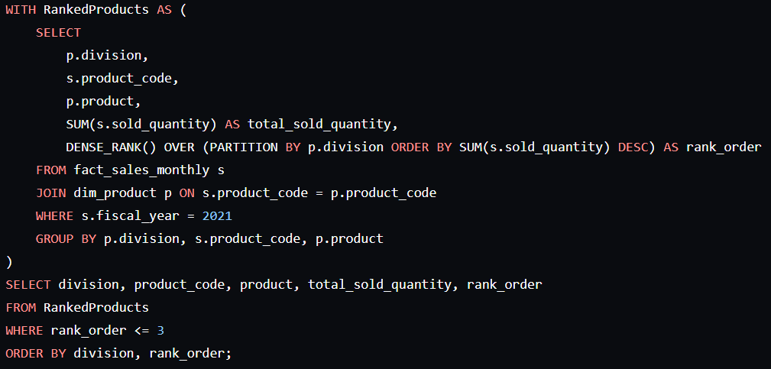
Get the Top 3 products in each division that have a high total_sold_quantity in the fiscal_year 2021?
The final output contains these fields, division, product_code, product, total_sold_quantity, rank_order
Request-10
Query

Slide 33
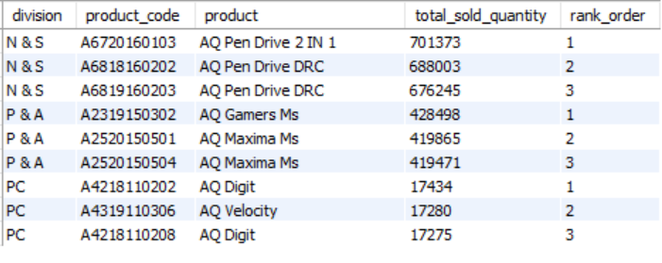
Get the Top 3 products in each division that have a high total_sold_quantity in the fiscal_year 2021?
The final output contains these fields, division, product_code, product, total_sold_quantity, rank_order
Request-10
Output

Slide 34
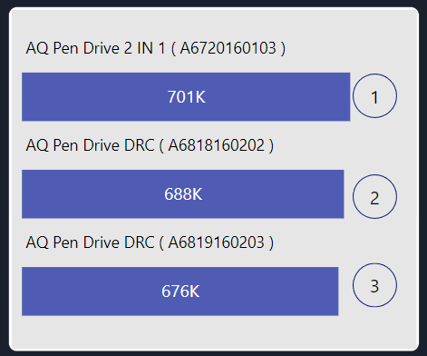
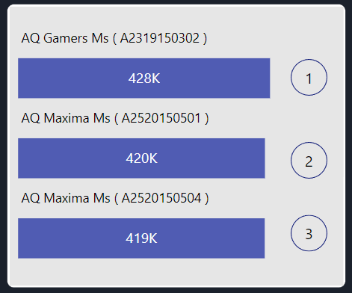
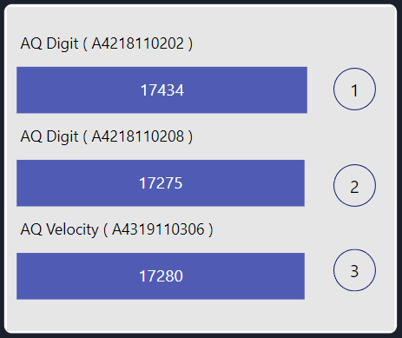
Request-10 Insight
Top 3 Products in Each division by
highest sold quantity
in
FY 2021
N & S
P & A
PC

Slide 35
Request-10 Insight
Insight:
Identified the top 3 products in each division by total sold quantity in 2021.
Recommendation:
Focus production and marketing efforts on these top-selling products to maximize revenue.
Leverage the success of these products by highlighting them in promotions and advertising campaigns.
Ensure optimal inventory levels for these products to meet demand and prevent stockouts.
Analyze customer feedback and market trends for these products to sustain and enhance their performance.

Slide 36
Conclusion
Conducted a comprehensive SQL analysis on Atliq Hardwares' sales and product data.
Key findings include a significant increase in unique products and identification of top-performing segments and customers.
Seasonal sales trends were uncovered, highlighting peak and low sales periods.
Recommendations focused on targeted R&D investments, cost-saving measures, strategic marketing efforts, and strengthening key sales channel relationships.
These insights will enable Atliq Hardwares to make informed decisions, optimize operations, and drive growth in the competitive computer hardware market.

Slide 37
Thank you!

